Slide 1
Deep Learning - I
Swakkhar Shatabda

Slide 2
Course Policy
Attendance – 5%
Mid Exam – 25%
Final Exam - 25%
Class Test – 20%
Assignment – 25%

Slide 3
Course Outline
Week 1: introduction, solving linear regression
Week 2: stochastic gradient descent, logistic regression
Week 3: introduction to neural networks
Week 4: backpropagation algorithms
Week 5: improving nn performance – i (class test 1)
Week 6: improving nn performance – ii (first presentation on assignment)
Mid exam
Week 7: intro to convolutional networks
Week 8: convolutional networks
Week 9: transfer learning, generative models
Week 10: intro to rnn (class test 2)
Week 11: different types of rnn
Week 12: summary and review (final presentation on assignment)
Final exam (submission of report on assignment )

Slide 4
Why Machine Learning?
For many problems, it’s difficult to program the correct behavior by hand
recognizing people and objects
understanding human speech
In traditional programming
Rules+Input gives Answer
In Machine Learning
Input + Answer gives rules

Slide 5
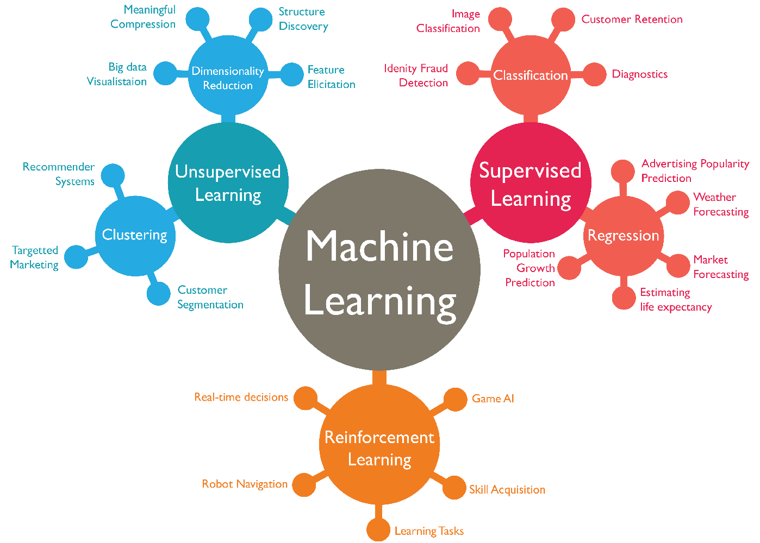
Machine Learning

Slide 6

Supervised Learning: Next What?
Select a Problem
Gather Data
Generate Features
Select Algorithm
Test It!
Deploy it!

Slide 7
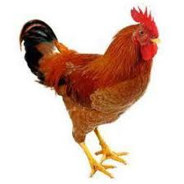
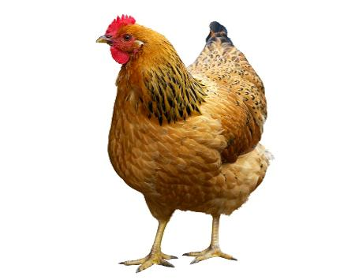
Step 1: Problem Formulation
DESHI VS BIDESHI
Help your Mom! Deshi Chicken vs Sonalika Chicken
This is a classification problem!

Slide 8
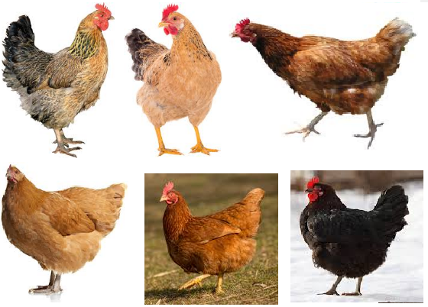
Step 2: Gather Data
DESHI
BIDESHI
Use your smart phone camera! You have it…. I Know.

Slide 9

Step 3: Featurization
Color
Comb
Hackle
Saddle
Claw
Sickle Feather
….
And if nothing pixels!

Slide 10


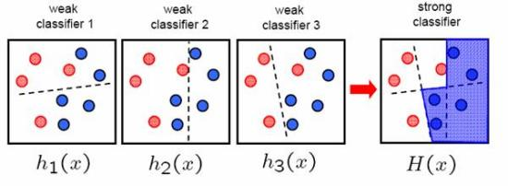
Step 4: Select Algorithm
Support
Vector
Machines
Artificial Neural Network
Adaboost
Classifier

Slide 11




Step 4: Select Algorithm

Slide 12
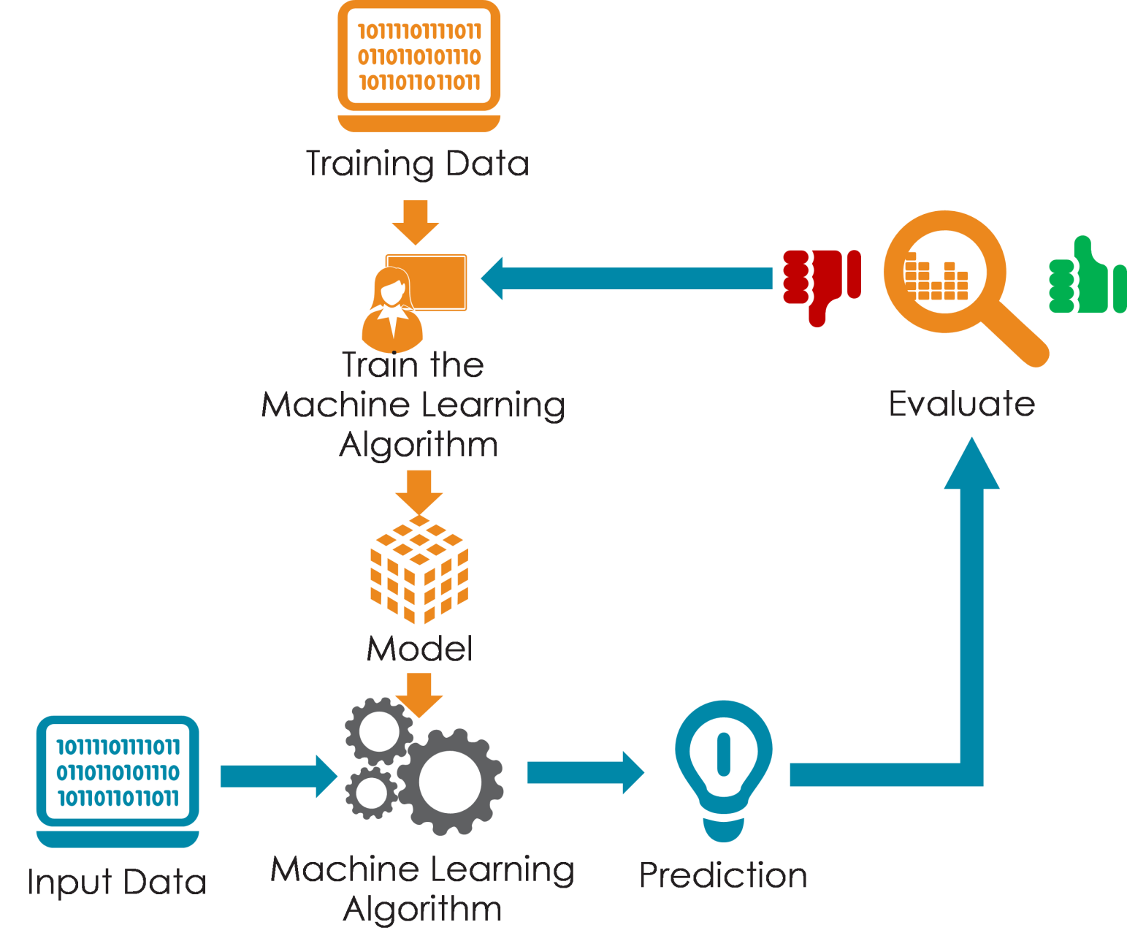
Step 5: Test your program!

Slide 13
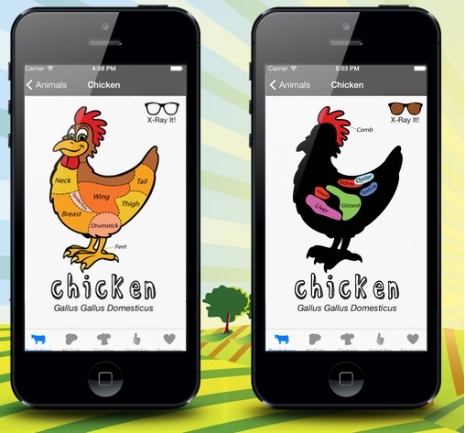
Step 6: Deployment
Make it usable for your Mom!
This is what the
big guys are doing?
Well, mostly!

Slide 14
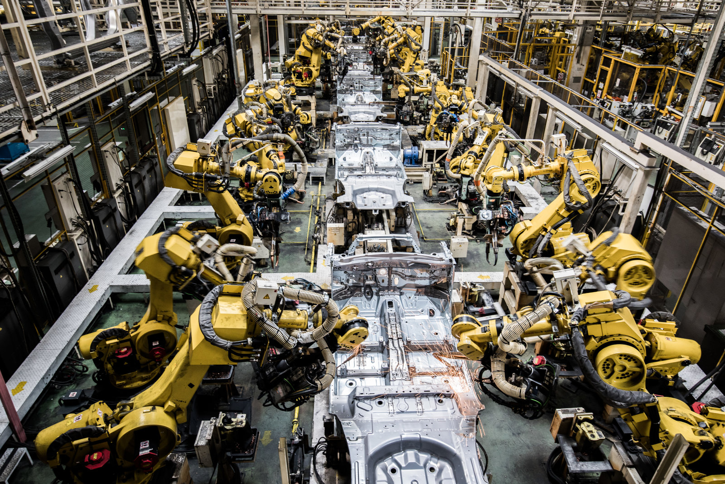
Manufacturing

Slide 15
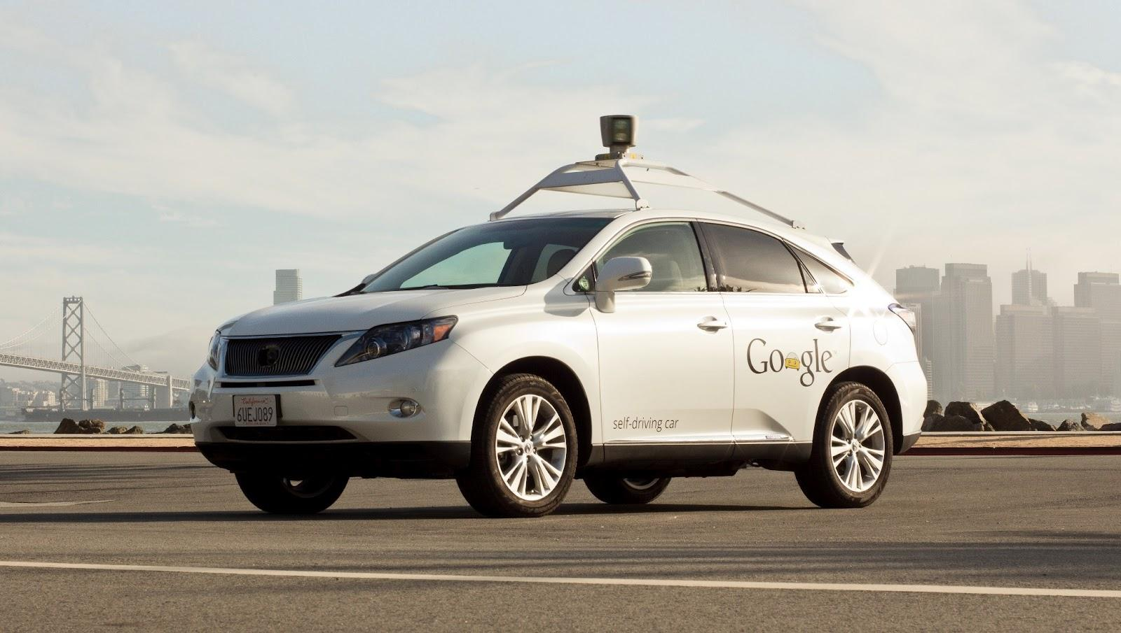
Taxi Driver

Slide 16
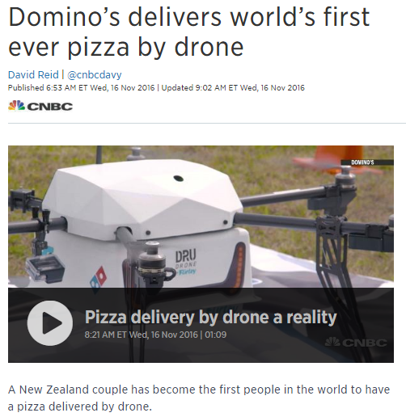
Pizza Delivery

Slide 17

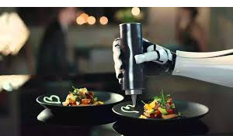
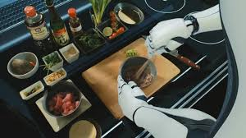
Cooking!

Slide 18
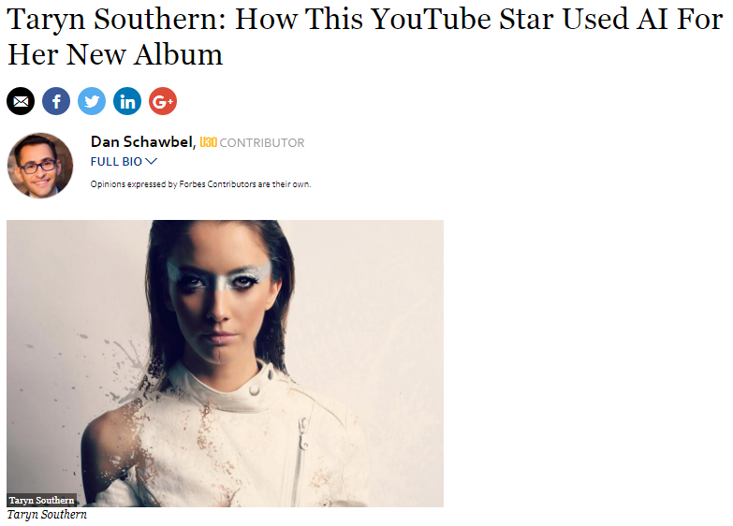
Music
I wish I could see…
Beyond…
what I see…

Slide 19
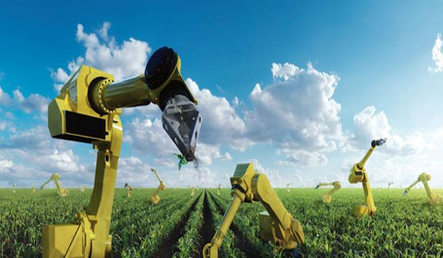
Agriculture

Slide 20
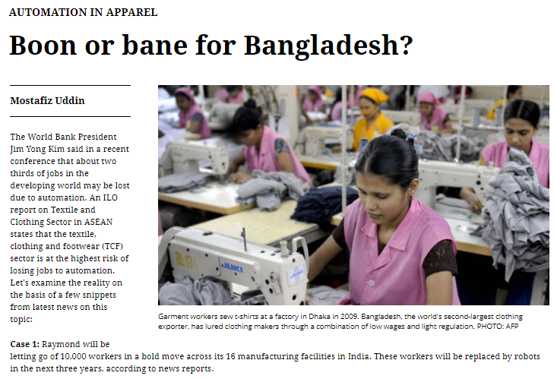
Any Implications?

Slide 21
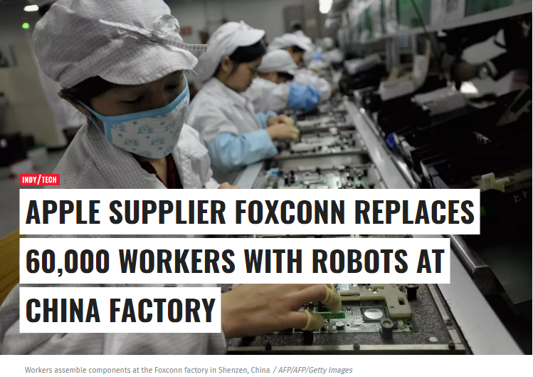
Manufacturing

Slide 22
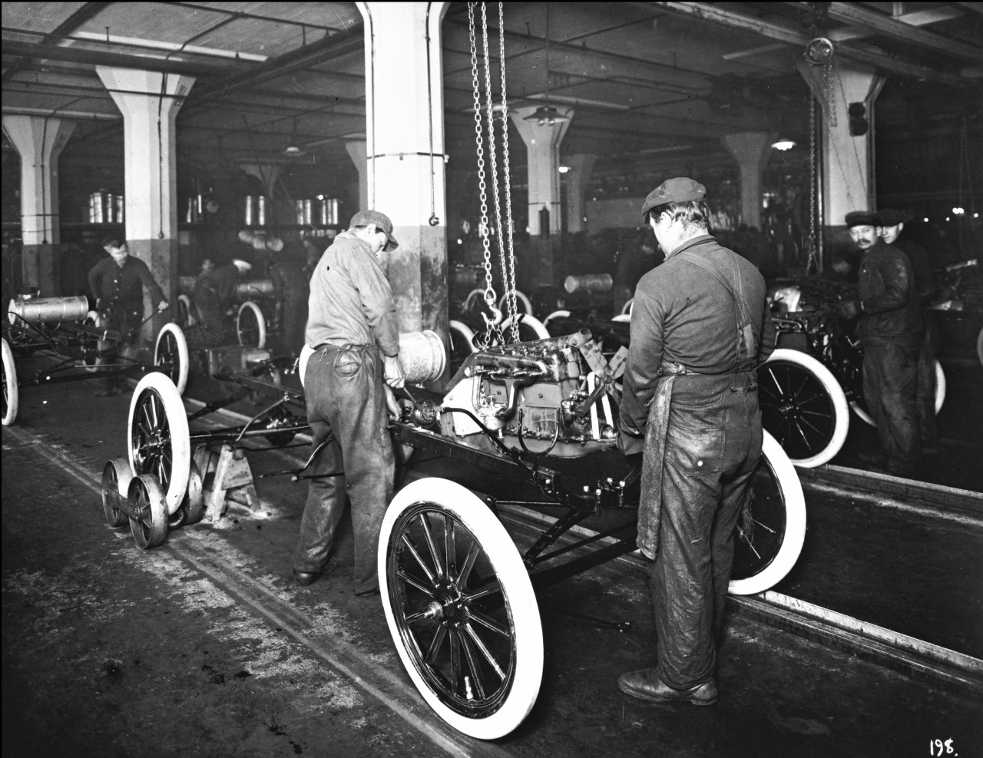
Manufacturing

Slide 23
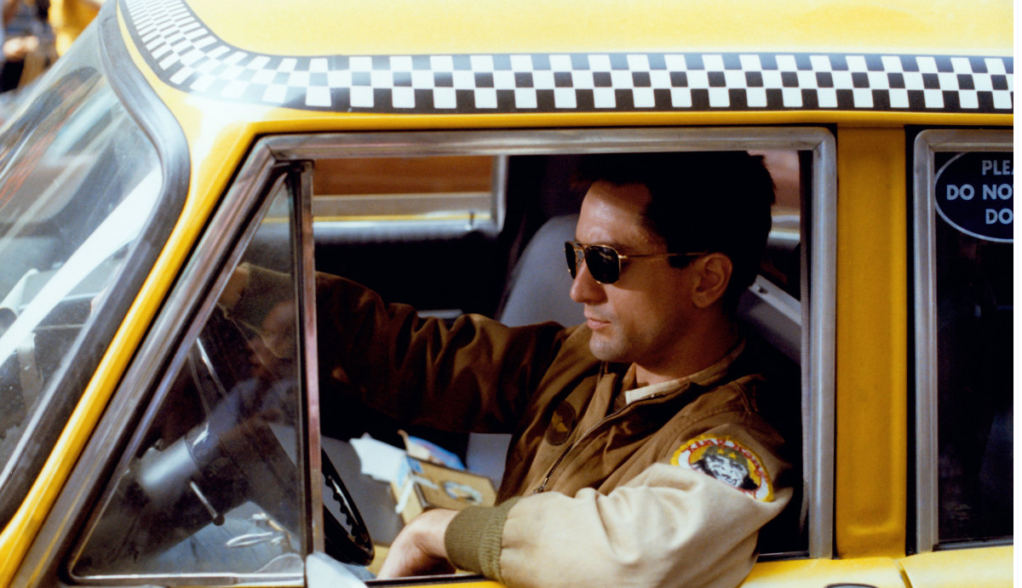
Taxi Driver

Slide 24

Taxi Driver
A jobless
taxi driver
Robert De Niro!

Slide 25
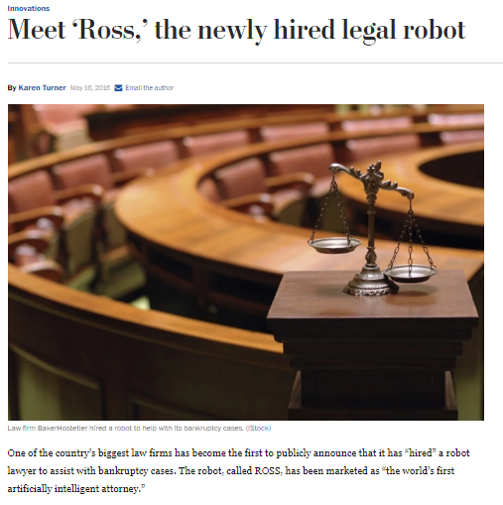
Beyond I could see
IT WILL
TAKE THE
JOBS IT
CAN TAKE

Slide 26
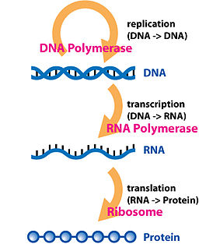
Bioinformatics
ALL
ARE
STRINGS

Slide 27
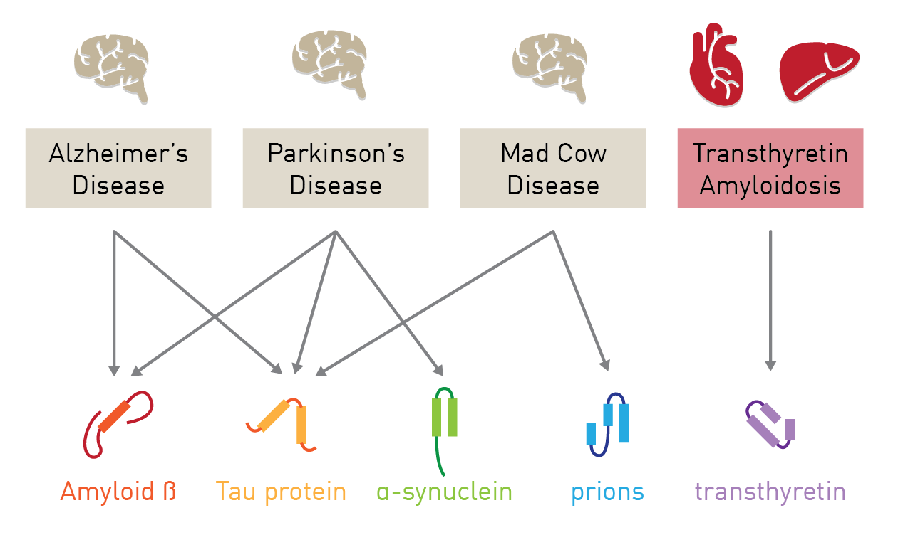
Proteins and Diseases!

Slide 28
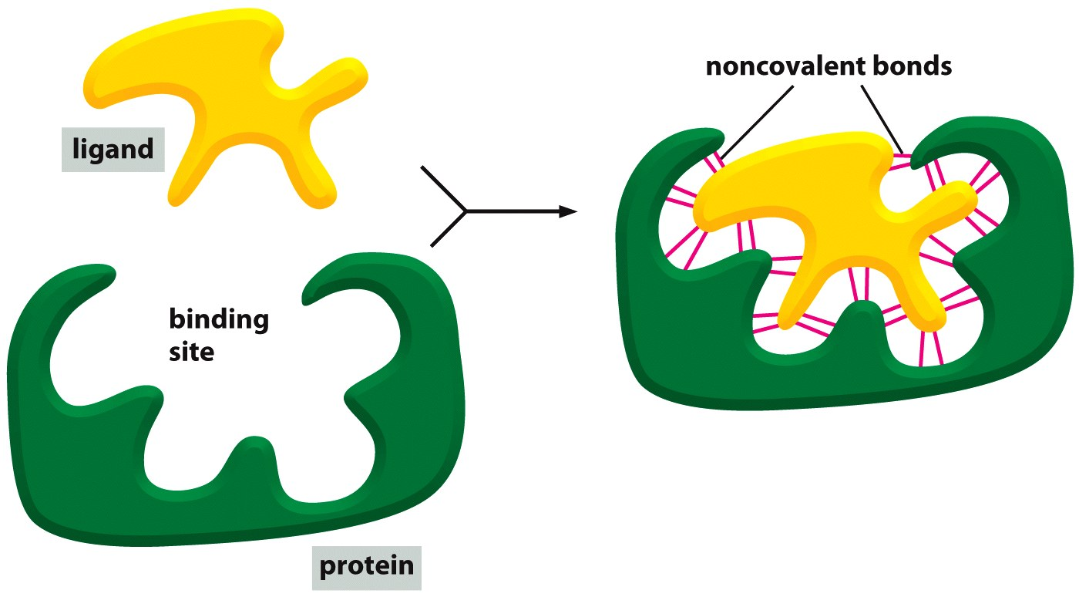
Rational Drug Discovery

Slide 29
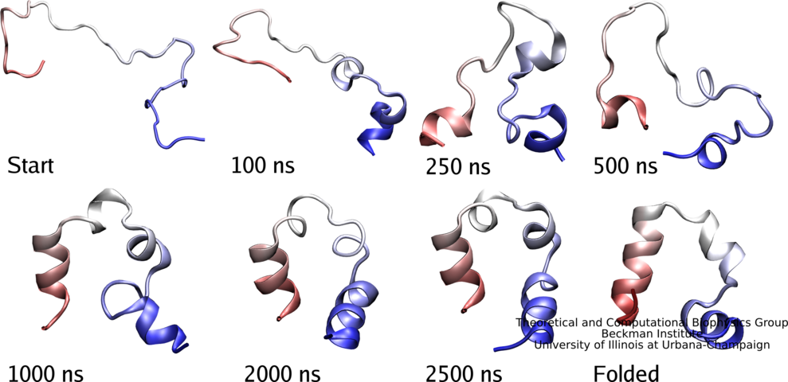
Protein Structures are Important!

Slide 30
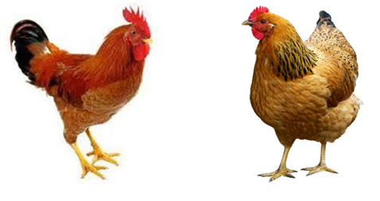
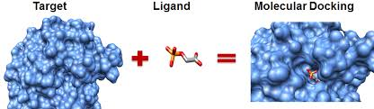
Another Analogy!
VS
ALL SUPERVISED
LEARNING?

Slide 31
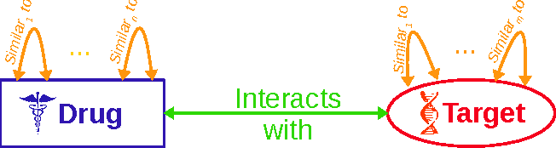
Step 1: Problem Formulation
Predict whether a drug and an protein will interact or not!

Slide 32



Step 2: Get Data
There are libraries of Drugs and Target information already verified!

Slide 33

Step 3: Generate Features
Drug Features
Molecules
Bonds
Structure
Protein Features
Sequence
Properties
Structure

Slide 34
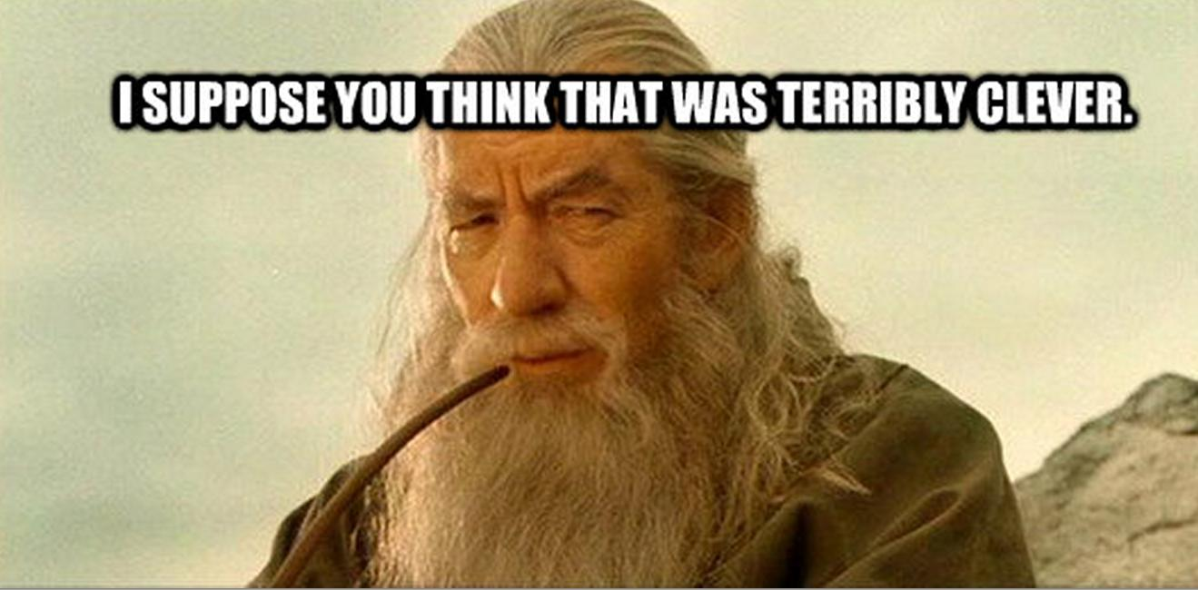
Step 4: Select Algorithm
We used scikit-learn, python and R
Selected Adaboost Classifier!

Slide 35

Step 5: Test it!
Yes
We tried many algorithms
We tried many datasets
And we are satisfied at last!

Slide 36
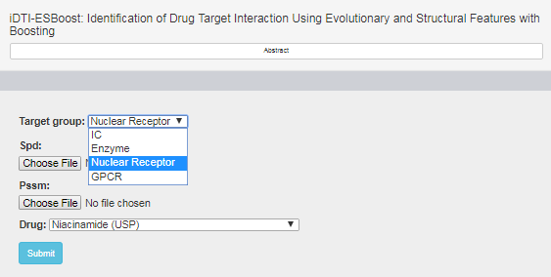

Step 6: Deployment
farshidrayhan.pythonanywhere.com/iDTI-ESBoost/
And we have published!

